Slide 1

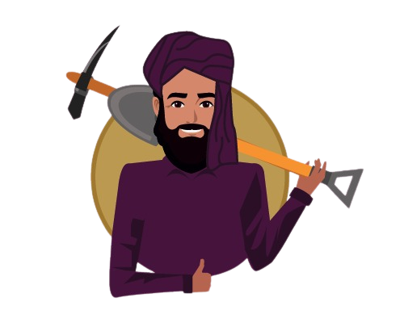



MazdoorHaazir Platform
(Mobile App & Web Platform)
Presented by: Danish Ul Hassan
Supervisor: Ms. Syeda Wajiha Naim

Slide 2
Introduction
The concept of “Mazdoor Haazir” is to develop a platform for the people who are struggling to find good Mistry’s and Labors to build their houses. There is not any online platform where we can find them and hire them (locally in Pakistan).
“Mazdoor Haazir” is a platform that connects customers to the skilled, experienced, and reliable service professionals in their own locality. “Mazdoor Haazir” is the one-stop destination for all areas' needs which includes cemetery, concrete laborers at your doorstep.

Slide 3
Problem Statement
Traditionally if we need any labor and workers to build our house or to paint our house, we usually try to find these workers using different sources (from friends and relatives).
There is no such platform where we can find them, in search of work they (mistris and workers) sit around the road corners and outside the local hotels to find the work and these spots are quite limited and most of the people don’t know about these spots.

Slide 4
Proposed Solution
Develop a platform (mobile application) namely “Mazdoor Haazir” for the mistris and labors where they can get the work opportunities by just registering on the platform and the users will hire them according to their needs.
“Mazdoor Haazir” is a platform that connects customers to the skilled, experienced and reliable service professionals in their own locality. “Mazdoor Haazir” is the one-stop destination for all areas needs which includes cemetery, concrete laborers at your doorstep.

Slide 5
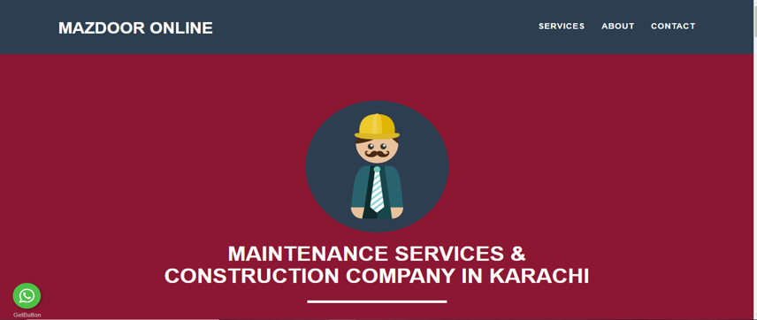
Competitor
Source: https://mazdooronline.pk/

Slide 6

How we are different?
Competitor
MHP
No concept of hiring
No direct link with labor
General purpose website
Time-consuming
Concept of hiring
Search specific area
Labour profiles
Targeted Market
Rating Concept

Slide 7
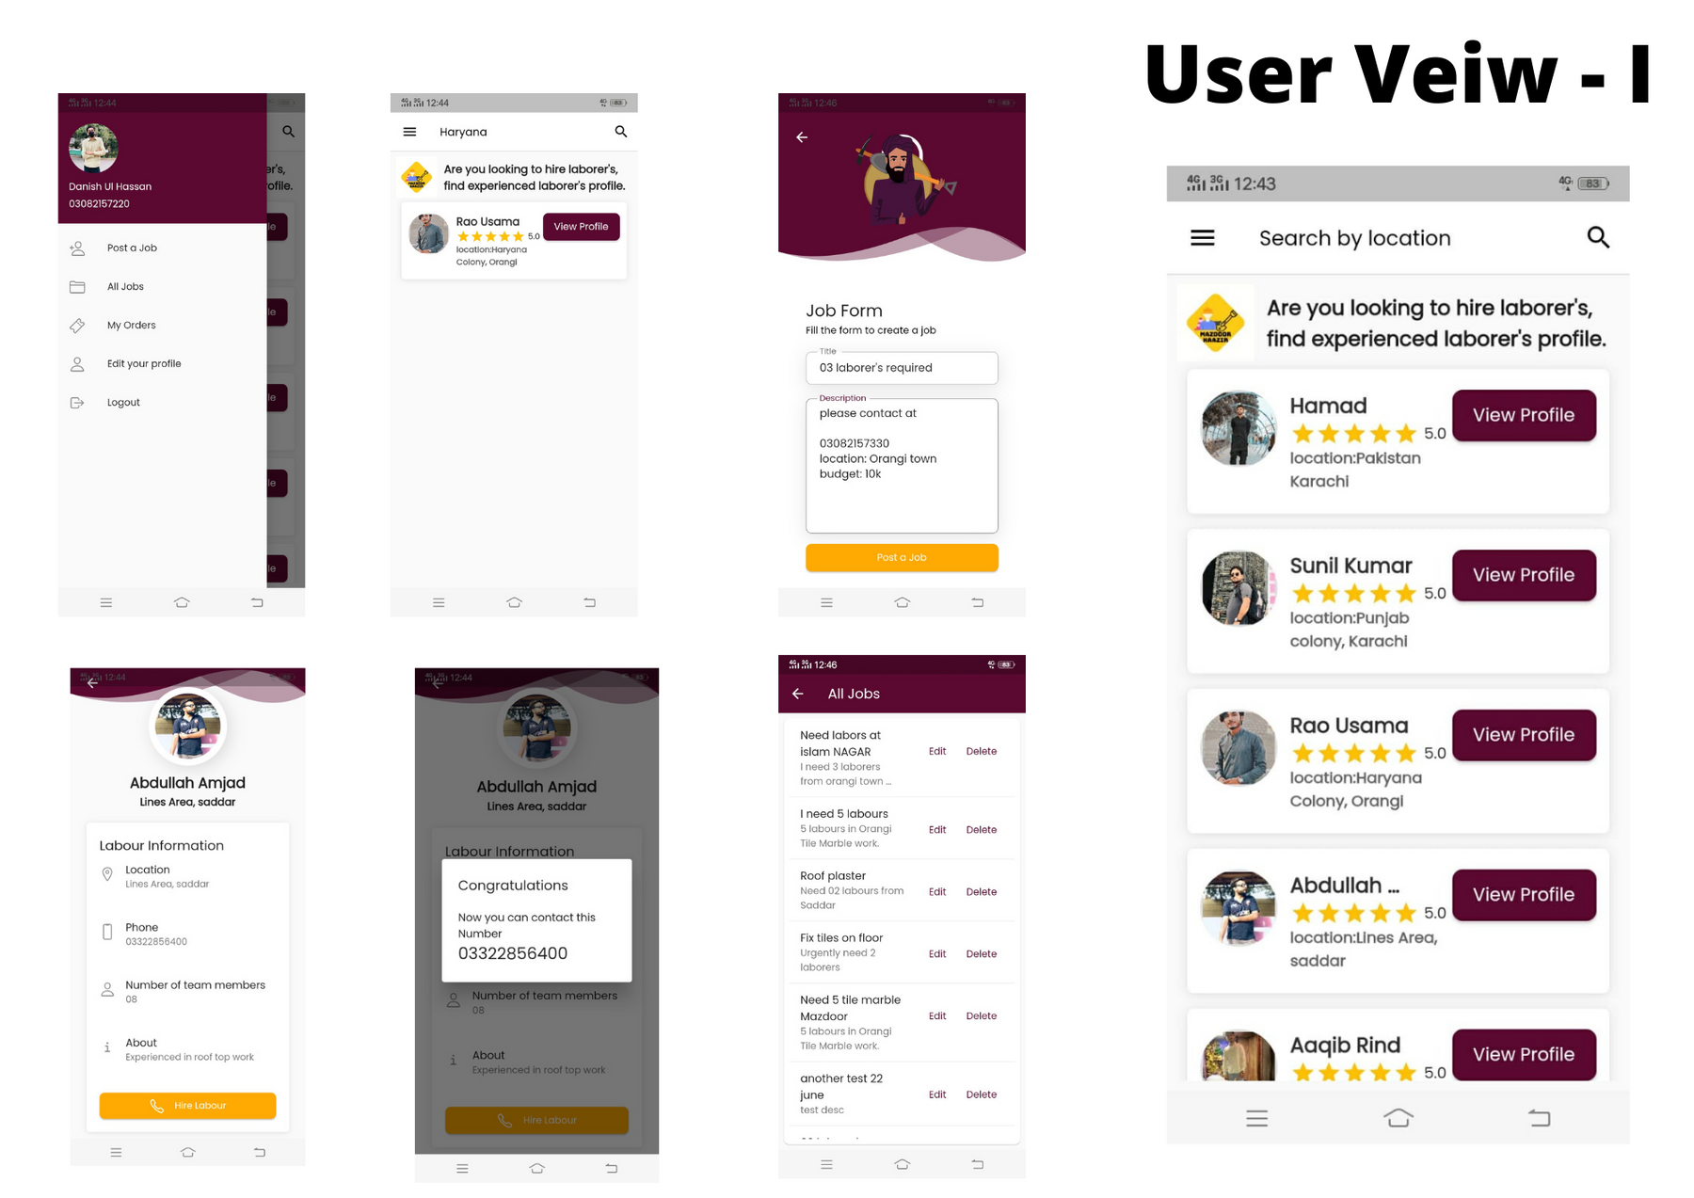

Slide 8
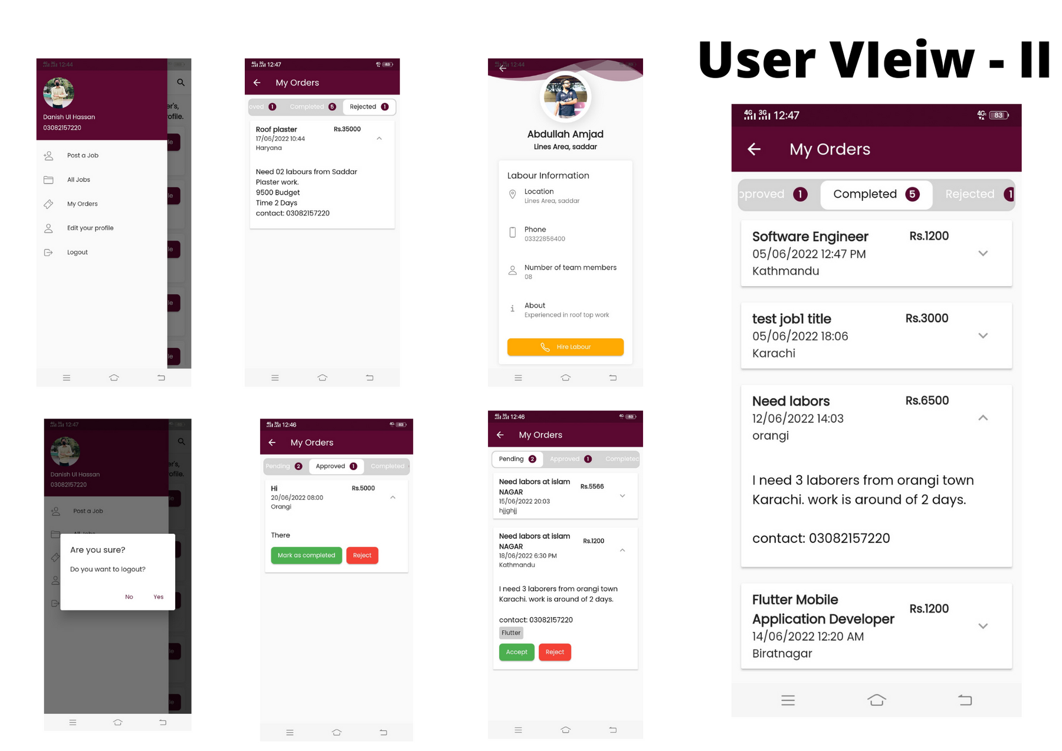

Slide 9
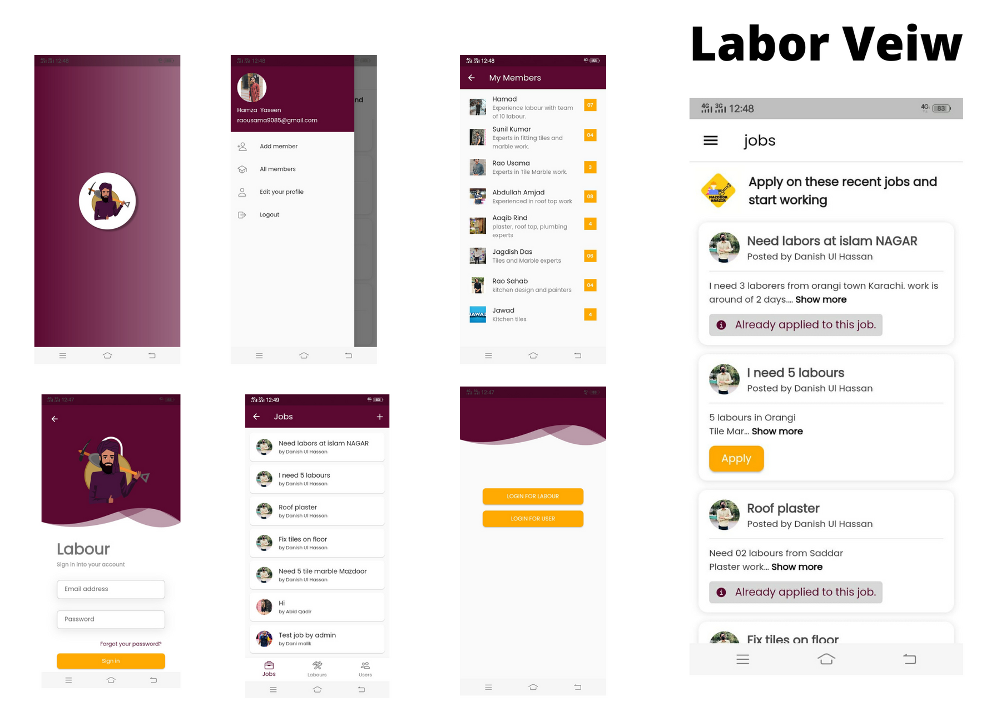

Slide 10
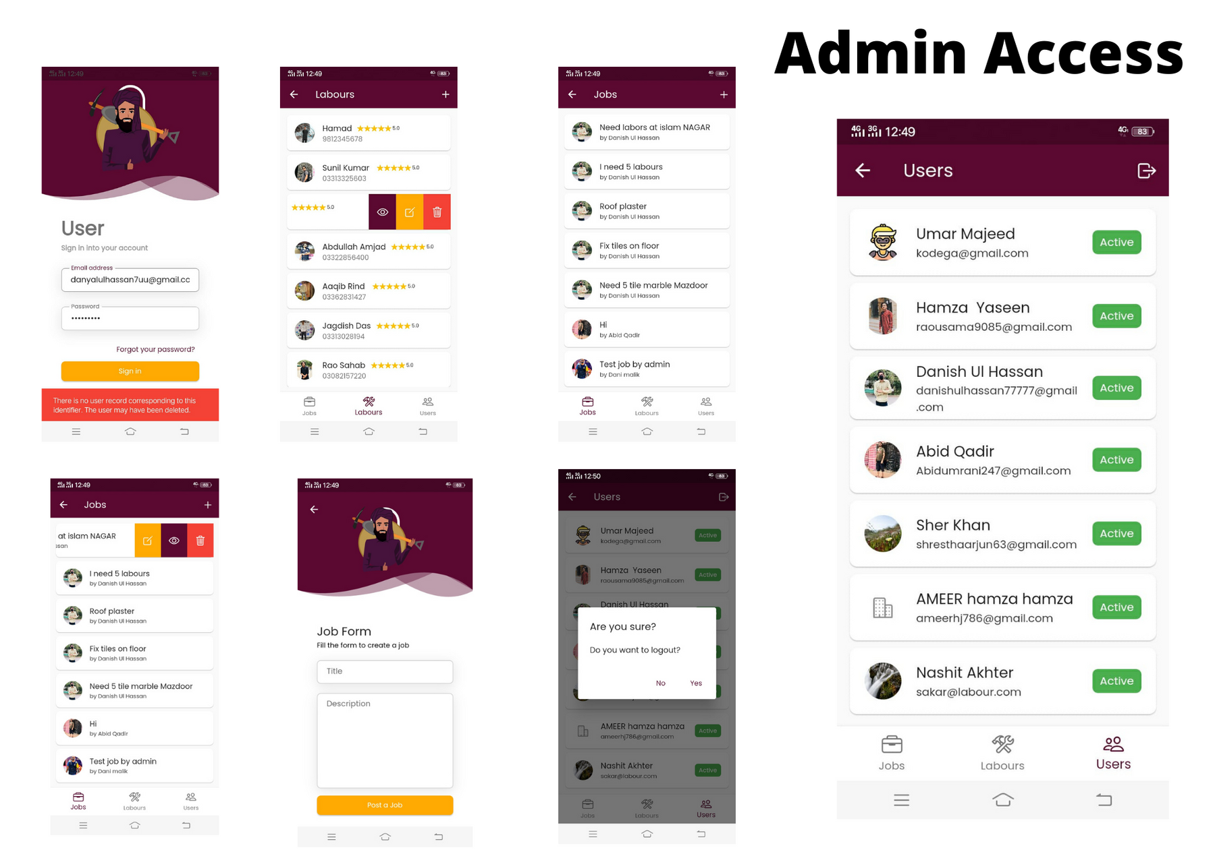

Slide 11










Tools & Technology Stack
WEB PLATFORM
MOBILE APP

Slide 12
Customers and Marketing Strategy
The competitors that we belong to is the online sector, where people is looking for job opportunities. (but our solely target will be the uneducated/illiterate domain)
The construction market is quite huge in Pakistan which captures the 17% of the industry.
Our customers will be the layman who is looking for labors/contractors on the doorstep.
For marketing strategy, we will use the social media platforms along with the strong awareness among the laborers.

Slide 13
Financials
The platform will adhere the principle of traditional freelance marketplaces and initially we will charge 10% of the contract amount from the user.
The platform will not charge anything from the direct contractors/laborers from their amount.
The platform will get some percentage from the companies (construction companies) if they land a contract through the platform.
On plus the potential org/companies can display their ads on the platform who are looking for laborers (Ad-based)

Slide 14

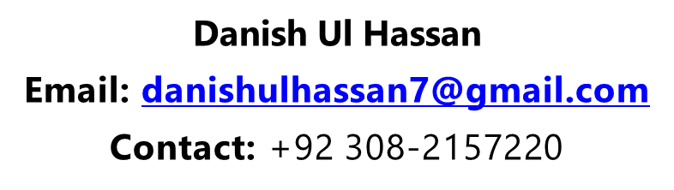


2017
Step 3
2019

Slide 15

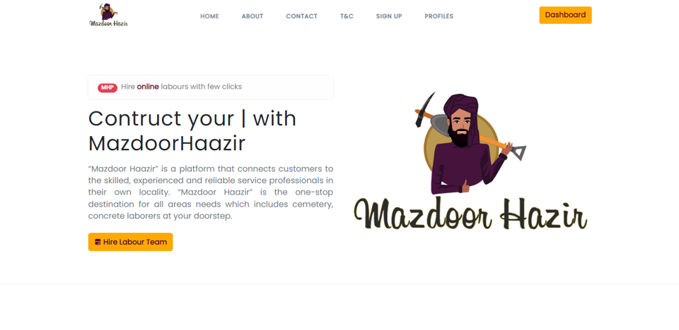
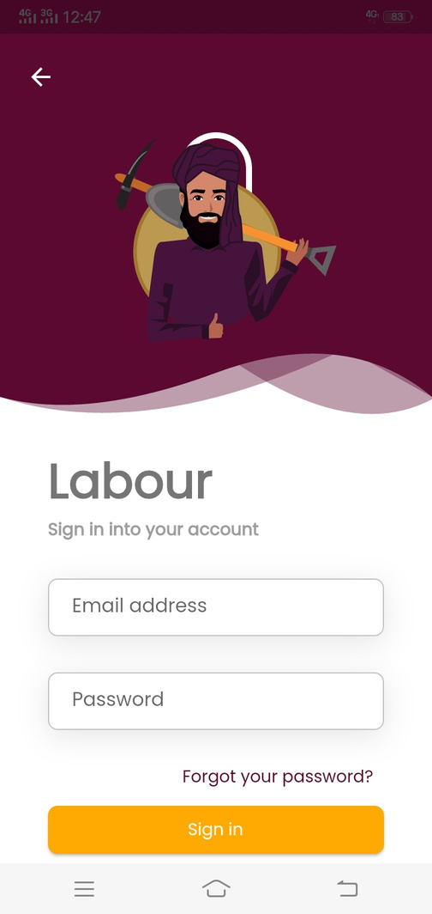


Thank You!
Visit https://mazdoorhaazir.com/

